Slide 1


SHORT TERM TRAINING PROGRAM
FOR STUDENTS OF BU-UIT BHOPAL
NITTTR-BHOPAL
Program Topic - Industrial Internet Of Things Mentor- Mr. Toshit Pathak (IOT industry expert)

Slide 2
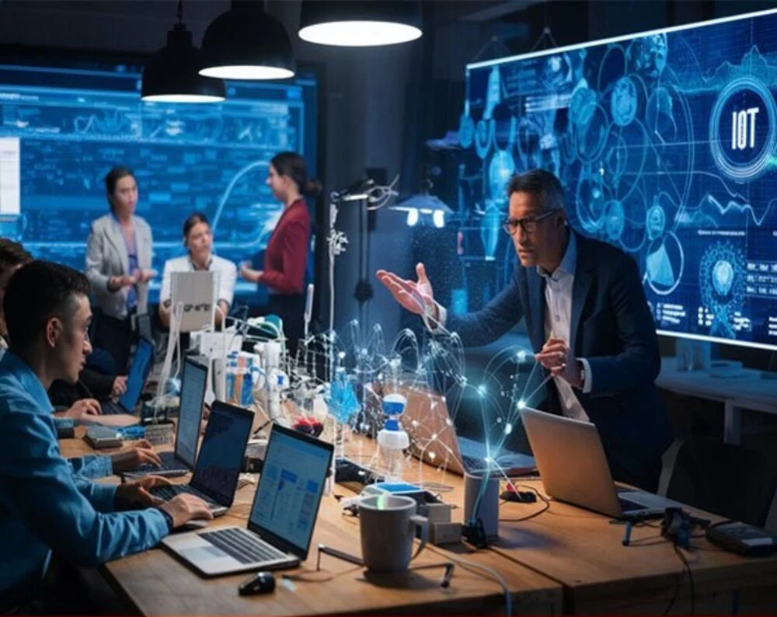
GROUP MEMBERS
ADITYA THAKUR
SRISHTI JATAV
JIYA CHOUKSEY
SAURABH SAHU
RUBI AHIRWAR
SHUBHI ARJARIYA
NISHA PATEL
SNEHA AHIRWAR

Slide 3
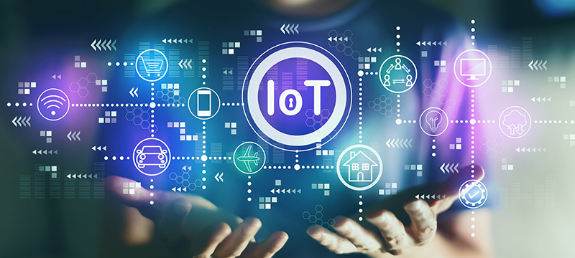
The Internet of Thinking:
Core Components Defined
Node - Red
Siemens MindSphere
MINDCONNECTING LIBRARY
GATEWAY
INDEX
Smart Factories in Manufacturing
Sustainable Smart Cities
Intelligent Financial Services
Healthcare Transformed
Navigating Challenges and Ethics
Future IoT Trends
The IoT Promise
Application
Advantage
Disadvantage

Slide 4

THE INTERNET OF THINKING:
A COGNITIVE REVOLUTION
1
Explore the Internet of Thinking (IoT), an evolution of IoT.
It emphasises cognitive capabilities, AI integration, and decision-making.
This presentation outlines its components, applications, challenges, and the UK's role in this technological shift.
2
3

Slide 5
CORE COMPONENTS DEFINED
Sensors & Data
AI & Machine Learning
Edge Computing
Communication Networks
High-fidelity sensors gather real-world data. This includes smart city sensors and health wearables.
Algorithms enable data analysis. They offer real-time insights with predictive capabilities.
Data processing is closer to the source. This reduces latency and enhances security.
5G provides reliable connectivity. It enables seamless data transfer and collaboration.

Slide 6
CORE COMPONENTS DEFINED
Asset
Aspect
Aspect Type
Virtual Asset
A physical or digital entity in an IoT system that generates data.
A specific characteristic or functionality of an asset that is monitored or controlled.
A predefined category or template that defines how an aspect is structured, measured, and analyzed
A digital representation of a physical asset, created to simulate, analyze, and optimize real-world performance in a virtual environment.

Slide 7
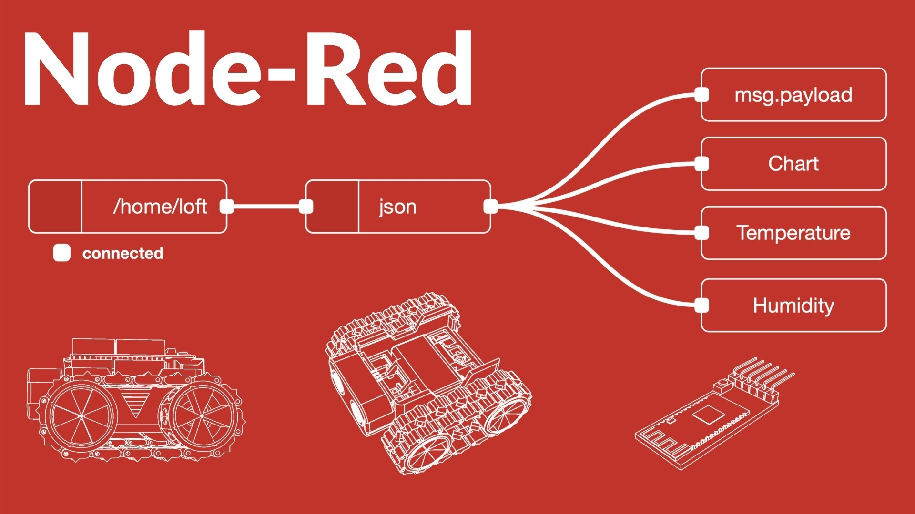
NODE - RED
Drag-and-Drop Interface
1
Simplifies the process of connecting IoT devices and services.
2
Pre-Built Nodes
Provides a wide range of ready-to-use modules for data processing and automation.
3
Event-Driven Workflow
Automates data collection, processing, and response actions.
4
Edge & Cloud Integration
Works with IIoT platforms like Siemens MindSphere, AWS IoT, and Azure IoT.
5
Real-Time Monitoring & Control
Enables live data visualization and decision-making.

Slide 8
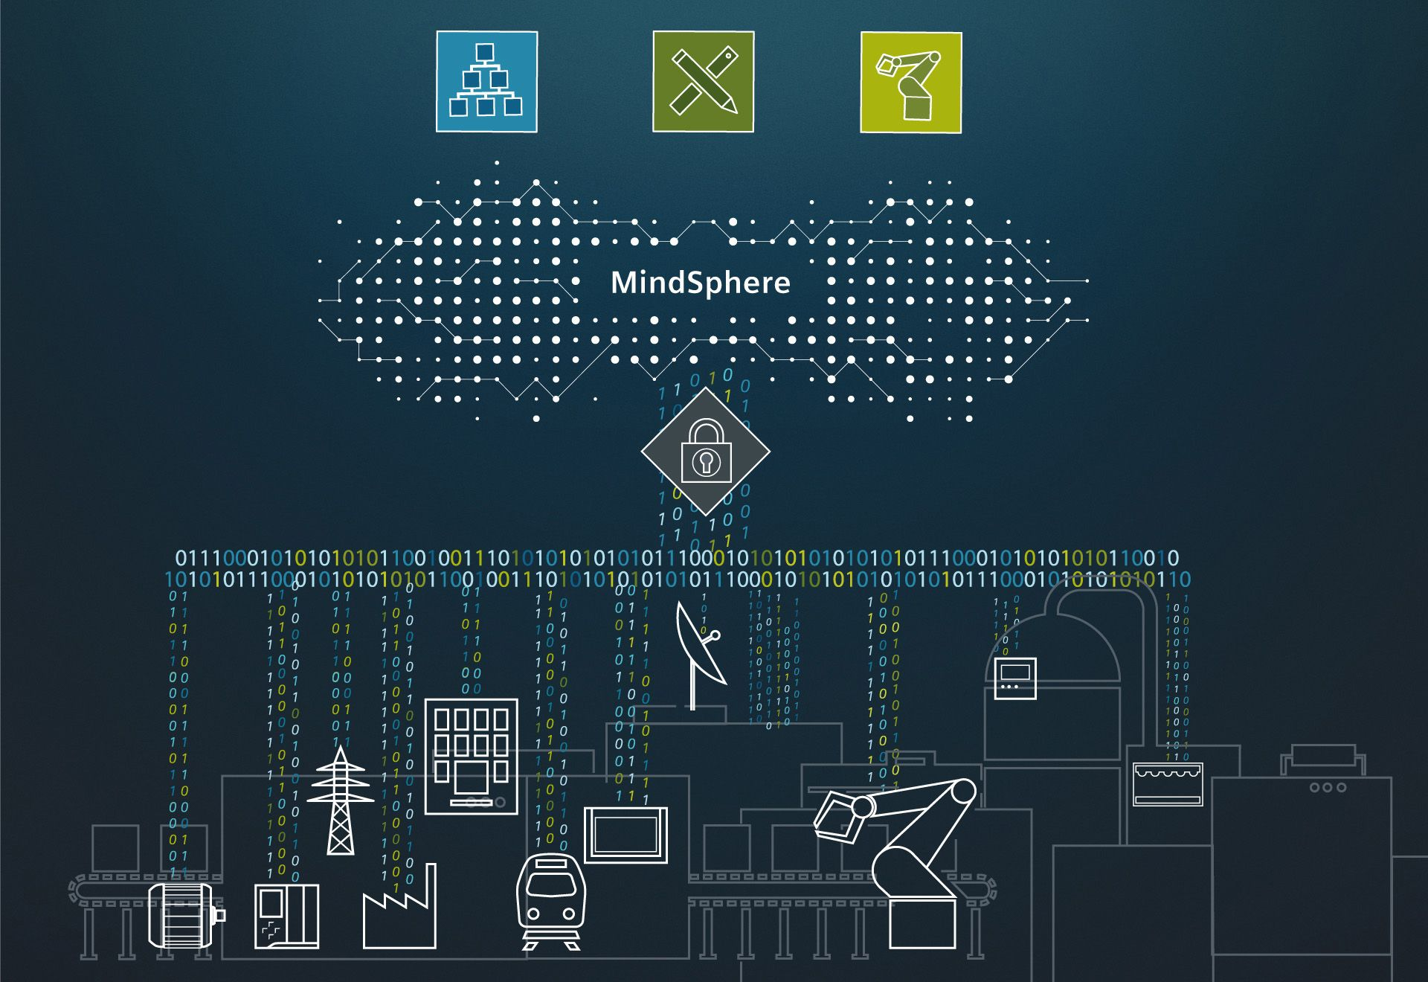
SIEMENS MINDSPHERE
Siemens MindSphere is a cloud-based, open IoT operating system that connects industrial machines and devices, enabling businesses to collect, analyze, and optimize data for smarter decision-making.
It is primarily designed for Industrial IoT (IIoT) applications, helping industries improve efficiency, productivity, and sustainability.

Slide 9
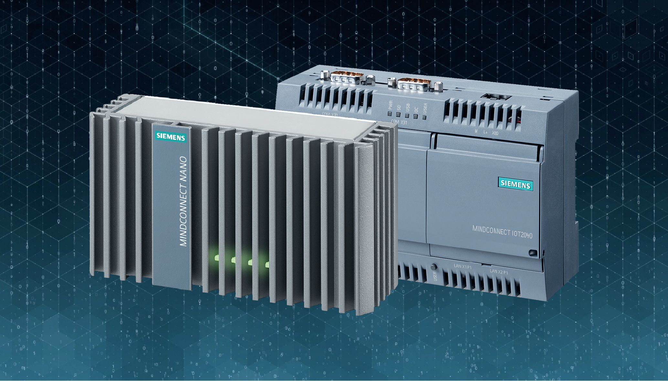
MINDCONNECTING LIBRARY
The MindConnect Library is a software development kit (SDK) provided by Siemens MindSphere that allows developers to connect third-party applications, devices, and industrial assets to MindSphere. It enables secure and reliable data transmission from edge devices to the cloud.

Slide 10
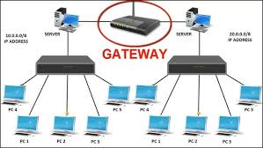
GATEWAY
Gateway Connectivity refers to the process of securely connecting industrial assets (machines, sensors, PLCs, and other devices) to Siemens MindSphere using MindConnect solutions.
This allows industries to collect, process, and analyze real-time data in the cloud for insights and optimization.

Slide 11
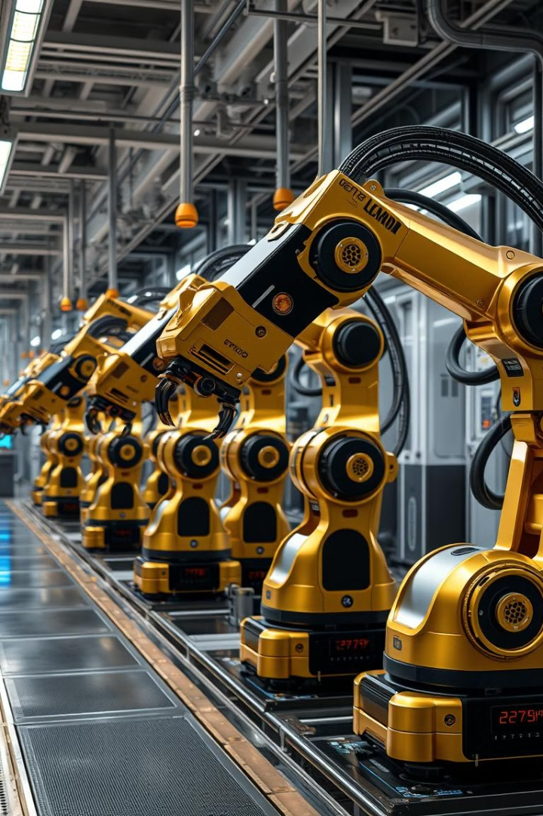
Smart FACTORIES IN MANUFACTURING
Predictive Maintenance
Real-Time Monitoring
Production processes are monitored in real-time, boosting efficiency by 10%.
Equipment maintenance anticipates downtime. Costs could decrease by 25%.
Automated Quality
AI and computer vision control quality,
cutting defect rates by 50%.

Slide 12

SUSTAINABLE SMART CITIES
1
Optimised Traffic
Traffic flow improves, reducing
commute times by 20%.
2
Smart Energy
Energy grids become efficient, decreasing energy consumption by 15%.
3
Public Safety
Intelligent surveillance enhances safety, speeding up emergency response times.

Slide 13
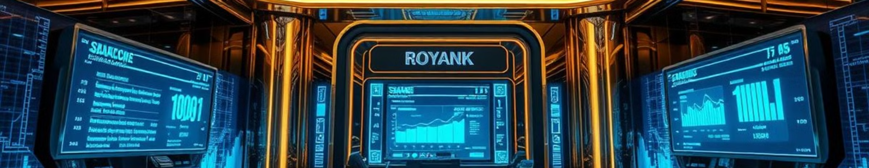



INTELLIGENTS FINANCIAL SERVICES
Machine learning detects fraud. It reduces fraudulent transactions by 40%.
Algorithmic trading optimises investments, improving portfolio performance by 12%.
Personalised advice is tailored to individual needs, boosting customer satisfaction.

Slide 14

HEALTHCARE TRANSFORMED
1
Remote Monitoring
2
AI Diagnostics
Wearable sensors monitor patients remotely. Hospital readmissions could fall by 30%.
AI detects diseases early and improves cancer screening accuracy by 15%.
3
Personalised Plans
Treatment plans adapt to individual data, optimising medication and improving outcomes.

Slide 15




NAVIGATING CHELLENGES AND ETHICS
Data Privacy
Ethical Considerations
Interoperability
Implement robust security to protect data. Ensure GDPR compliance.
Ensure AI fairness and transparency. Address potential biases.
Develop data exchange standards. Avoid vendor lock-in.

Slide 16




FUTURE IOT TRENDS
Blockchain Integration
1
Quantum Computing
2
4
Sustainability
3
New Business Models
IoT will integrate with blockchain and quantum computing. Expect new revenue streams and a focus on sustainability in developing countries.

Slide 17

THE IOT PROMISE
The Internet of Thinking transforms industries.
It improves lives through automation. Address challenges via collaboration.
The UK is well-positioned to lead this revolution. Embrace IoT and contribute to its future.

Slide 18
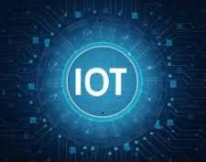
APPLICATION
Smart Agriculture System
IoT-Based Health Monitoring
Smart Parking System
Weather Monitoring System
Smart Agriculture System

Slide 19
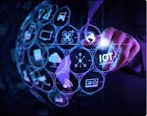
ADVANTAGE
Hands-on Learning
Innovation & Research
Interdisciplinary Collaboration
Industry Readiness
Remote Monitoring & Control
Cloud & Data Analytics Integration

Slide 20
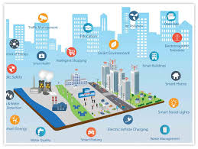
DISADVANTAGE
Security Risks
Complexity in Integration
Data Management Issues
High Initial Setup Cost
Network Dependency
Maintenance Overhead

Slide 21
Thank YOU

